Slide 1
AVR Serial Port Programming in Assembly and C
www.MicroDigitalEd.com

Slide 2
Topics
Parallel vs. Serial
Simplex vs. duplex vs. full duplex
Synchronous vs. asynchronous
Data framing and bps
RS232 Standard
RS232 connections to AVR and MAX232
AVR Serial Port Programming
  UBRR and baud rate
  Baud rate error calculation
  UDR register
  UCR registers
  Writing a program in assembly and C
www.MicroDigitalEd.com

Slide 3
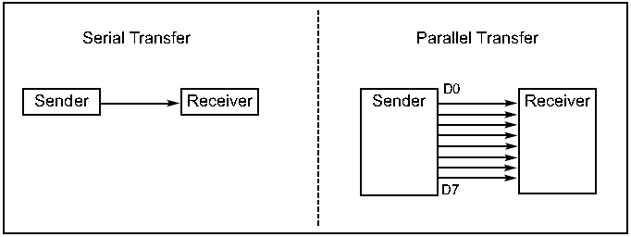
Parallel vs. Serial
Parallel
  Transfer a byte of data at a time -> faster, easier
Serial
  Transfers a bit after another -> cheaper, ideal for long distance through phone line (modem is needed)
www.MicroDigitalEd.com

Slide 4
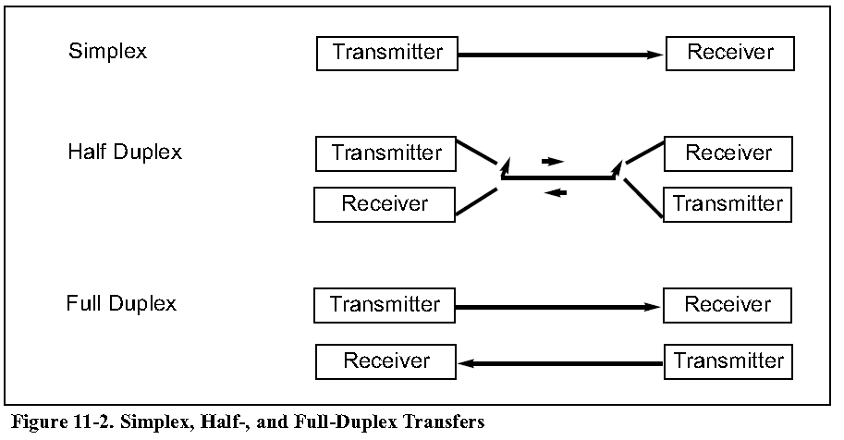
Direction
Simplex: data can moves only in one directions
Half Duplex: data can moves in two direction but not at the same time
Full Duplex: data can moves in two direction at the same time
www.MicroDigitalEd.com

Slide 5
Synchronous vs. asynchronous
Synchronous
  Clock pulse should be transmitted during data transmission.
  Only one side generates clock at the same time.
Asynchronous
  Clock pulse is not transmitted.
  The two sides should generate clock pulse.
  There should be a way to synchronize the two sides.
www.MicroDigitalEd.com

Slide 6
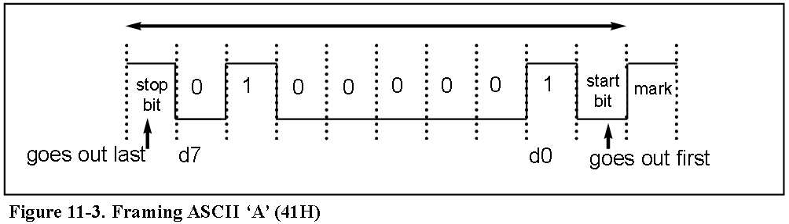
Data framing and bps
To synchronize the two sides, framing is used:
  Each frame starts with a space (0) which is called Start bit
  A character of 7-9 bits is transmitted after start bit
  [a bit of parity can be transmitted after the character] (optional)
  Each frame is ended by one or two mark (1) which is called stop bit(s).
Numbers of bit transmitted in a second is called bps
www.MicroDigitalEd.com

Slide 7
RS232 Standard
RS232 was set by the Electronics Industries Association (EIA) in 1960.
Because the standard was set long before the advent of the TTL logic family, its input and output voltage levels are not TTL compatible.
A 1 is represented by −3 to −25 V
A 0 is represented by +3 to +25 V
www.MicroDigitalEd.com

Slide 8
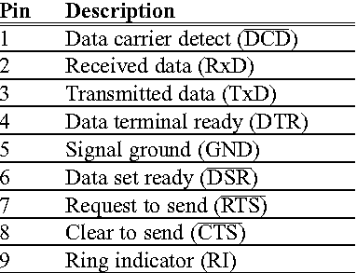
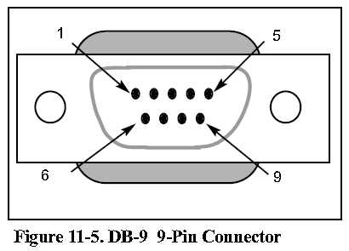
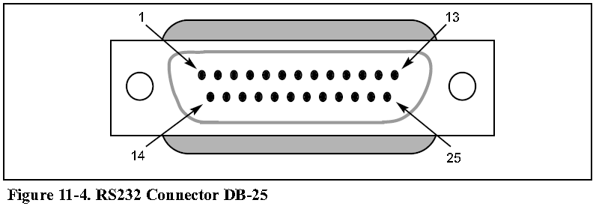
RS232 Pins
DB 25 used to be the standard connector of RS232
Now DB9 is used instead of DB25
www.MicroDigitalEd.com

Slide 9
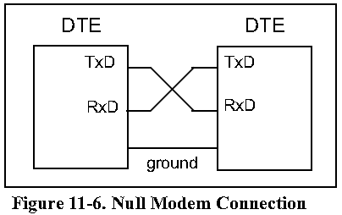
Null modem connection
DTE (Data Terminal Equipment) refers to terminals and computers that send and receive data.
To connect two DTE, we connect TXD of one device to RXD of the other and vise versa. It is called Null Modem Connection
www.MicroDigitalEd.com

Slide 10
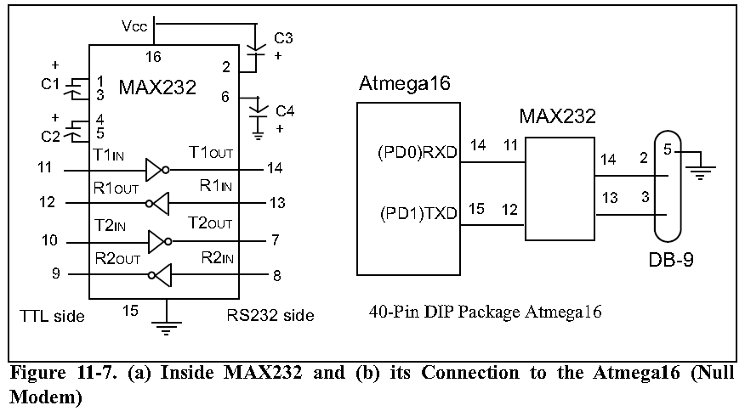
AVR Connection
www.MicroDigitalEd.com

Slide 11
USART in AVR
AVR supports: normal asynchronous, double speed asynchronous, master synchronous and Slave synchronous mode features.
We concentrate on Asynchronous mode to connect the AVR to a PC
In AVR 5 Registers are associated with USART
  UBRR ( USART Baud Rate Reegister)
  UDR ( USART Data Register)
  UCSRA ( USART Control and Status Register A)
  UCSRB ( USART Control and Status Register B)
  UCSRC ( USART Control and Status Register C)
www.MicroDigitalEd.com

Slide 12
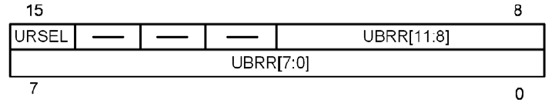
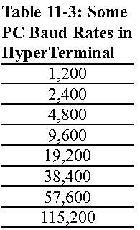
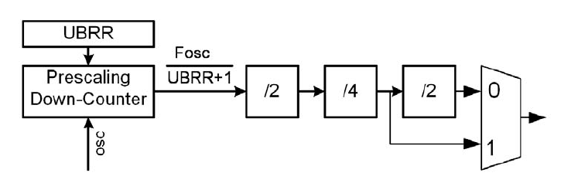
UBRR register and baud rate
The two sides have to agree on a baud rate
Table 11-3 shows standard baud rates of PC
To set the baud rate in AVR you should set the value of UBRR
www.MicroDigitalEd.com

Slide 13
Baud Rate Error Calculation
When we calculate the value of UBRR, the result may not be integer value but we can load only integer values in UBRR register -> baud rate error
Error = ( calculated value – int part)/ int part
Error = (calculated baud rate – desired baud rate) / desired baud rate
To omit baud rate error some specific Crystals can be used:
  11.0592 MHz
  7.3728 MHz
www.MicroDigitalEd.com

Slide 14
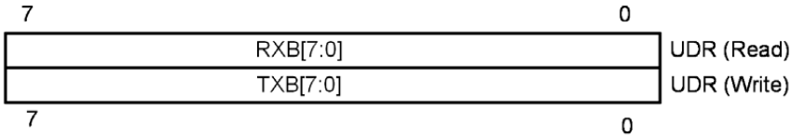
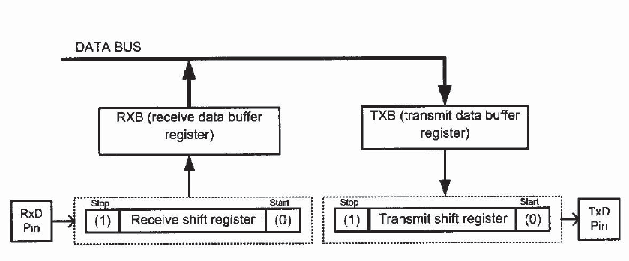
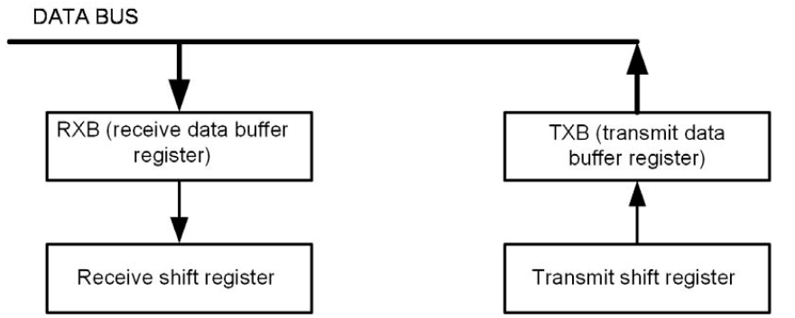
UDR
UDR is a bridge between you and the serial shift register
If you read UDR, data is read from received shift register
If you write to UDR, data is written into transmit shift register
www.MicroDigitalEd.com

Slide 15
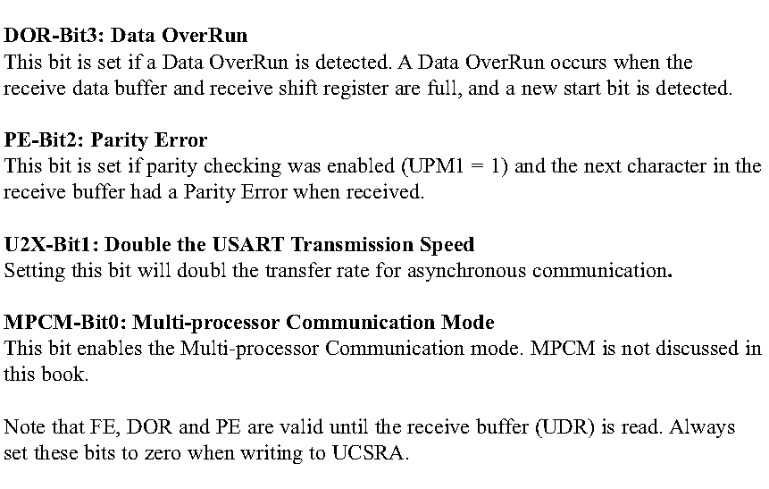
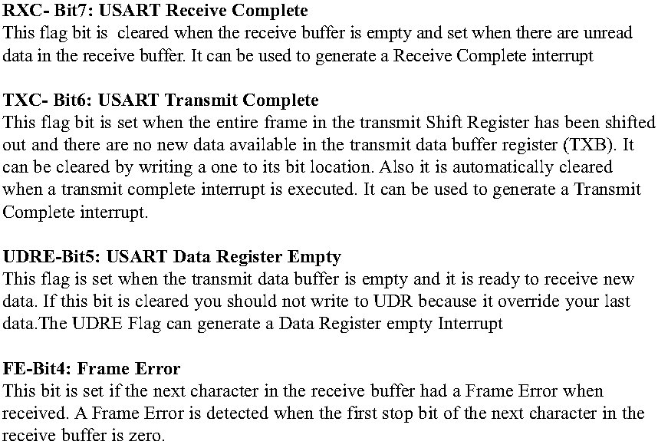
UCSRA
www.MicroDigitalEd.com

Slide 16
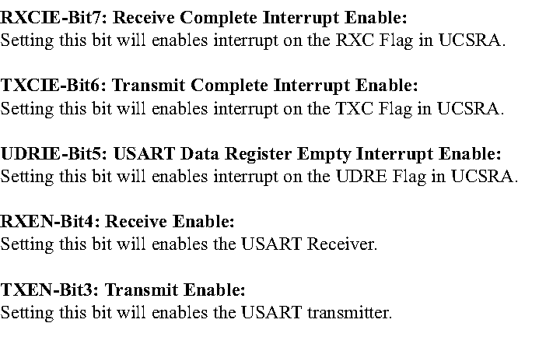
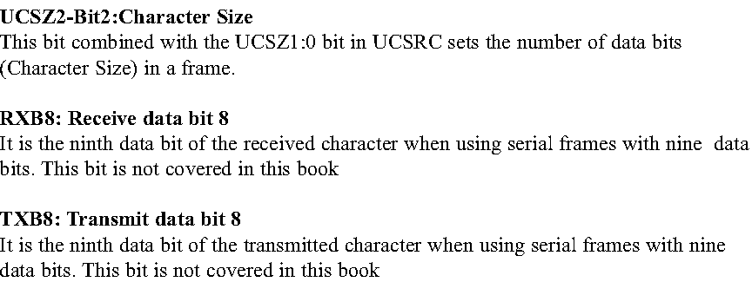
UCSRB
www.MicroDigitalEd.com

Slide 17
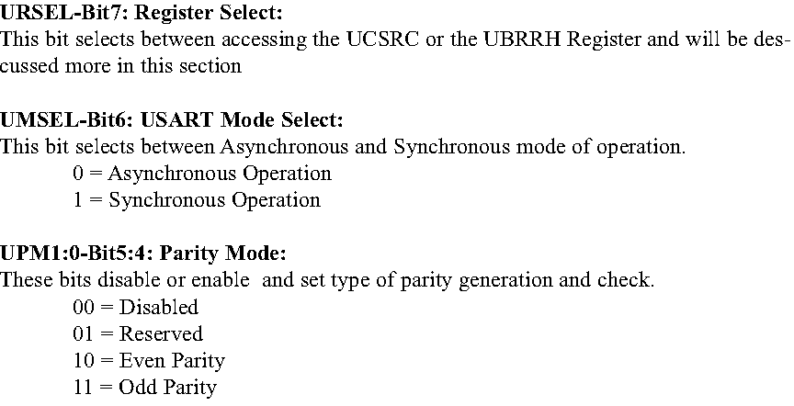
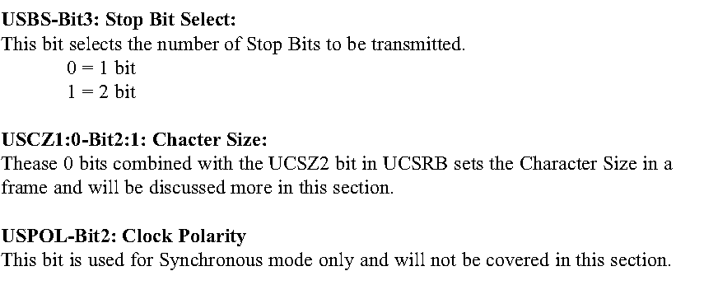
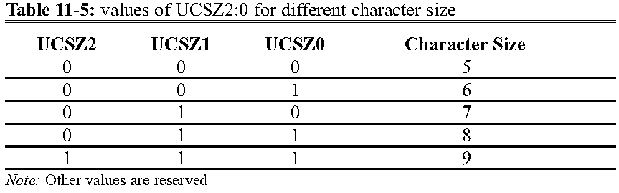
UCSRC
www.MicroDigitalEd.com

Slide 18
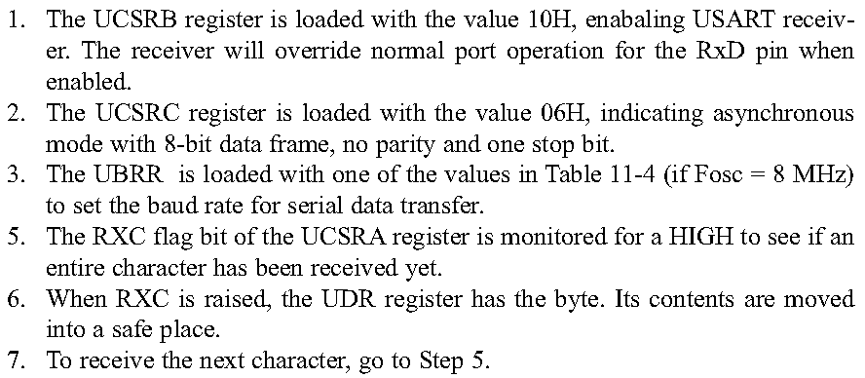
Serial Port Programming
www.MicroDigitalEd.com

Slide 19
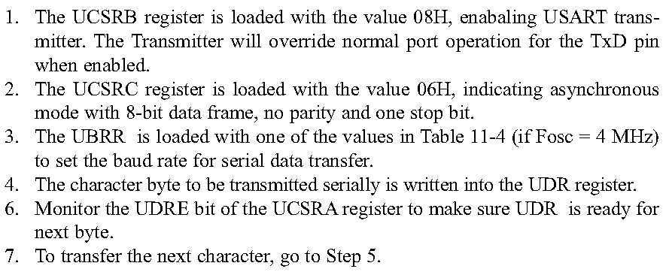
Serial Port Programming
www.MicroDigitalEd.com

Slide 20
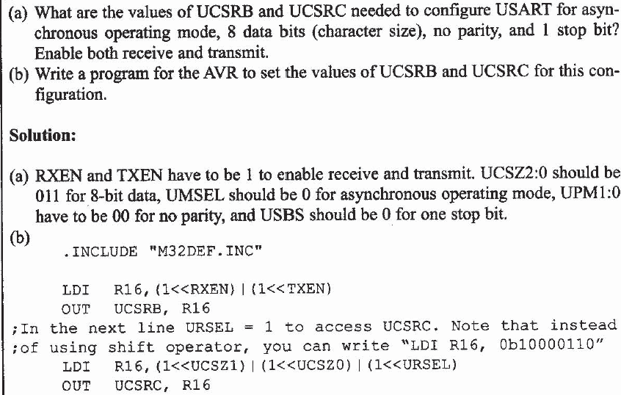
www.MicroDigitalEd.com

Slide 21
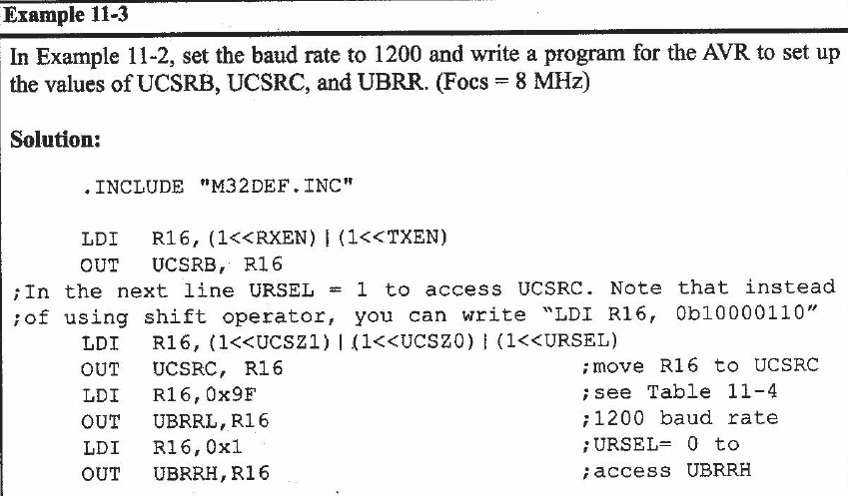
www.MicroDigitalEd.com

Slide 22
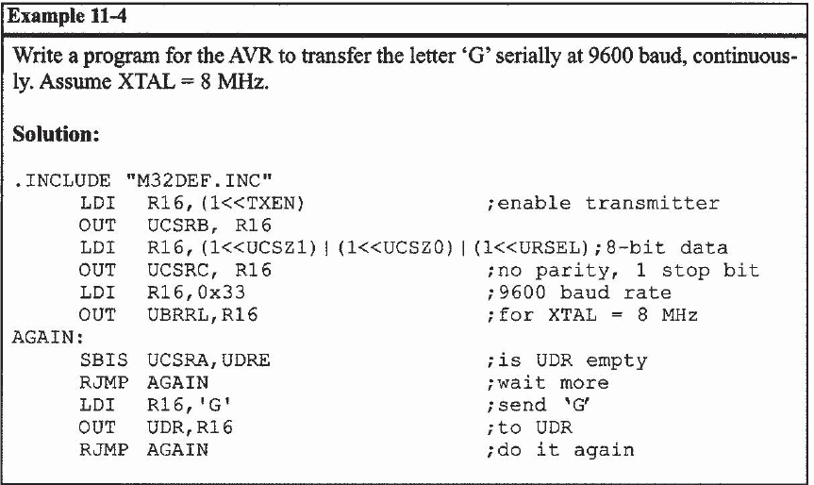
Serial Tranmit
www.MicroDigitalEd.com

Slide 23
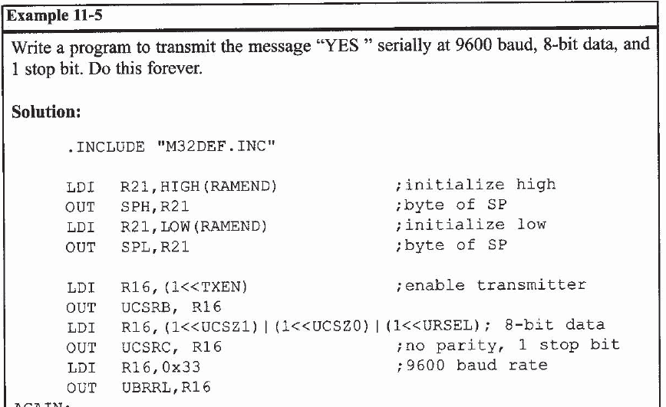
Transmit “YES”
www.MicroDigitalEd.com

Slide 24
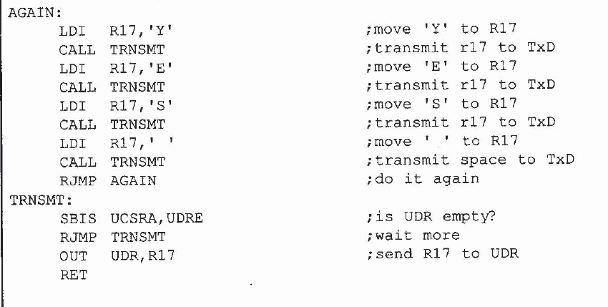
www.MicroDigitalEd.com

Slide 25
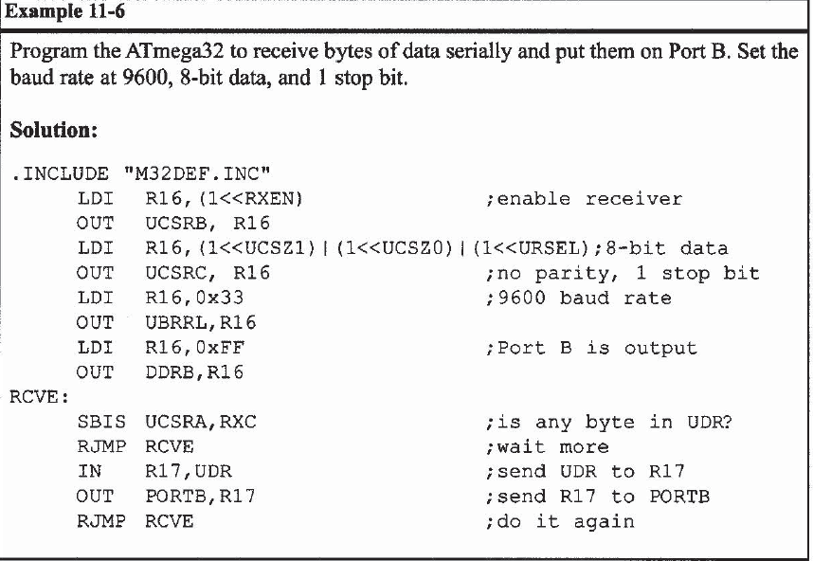
Receive Serially
www.MicroDigitalEd.com

